Slide 1
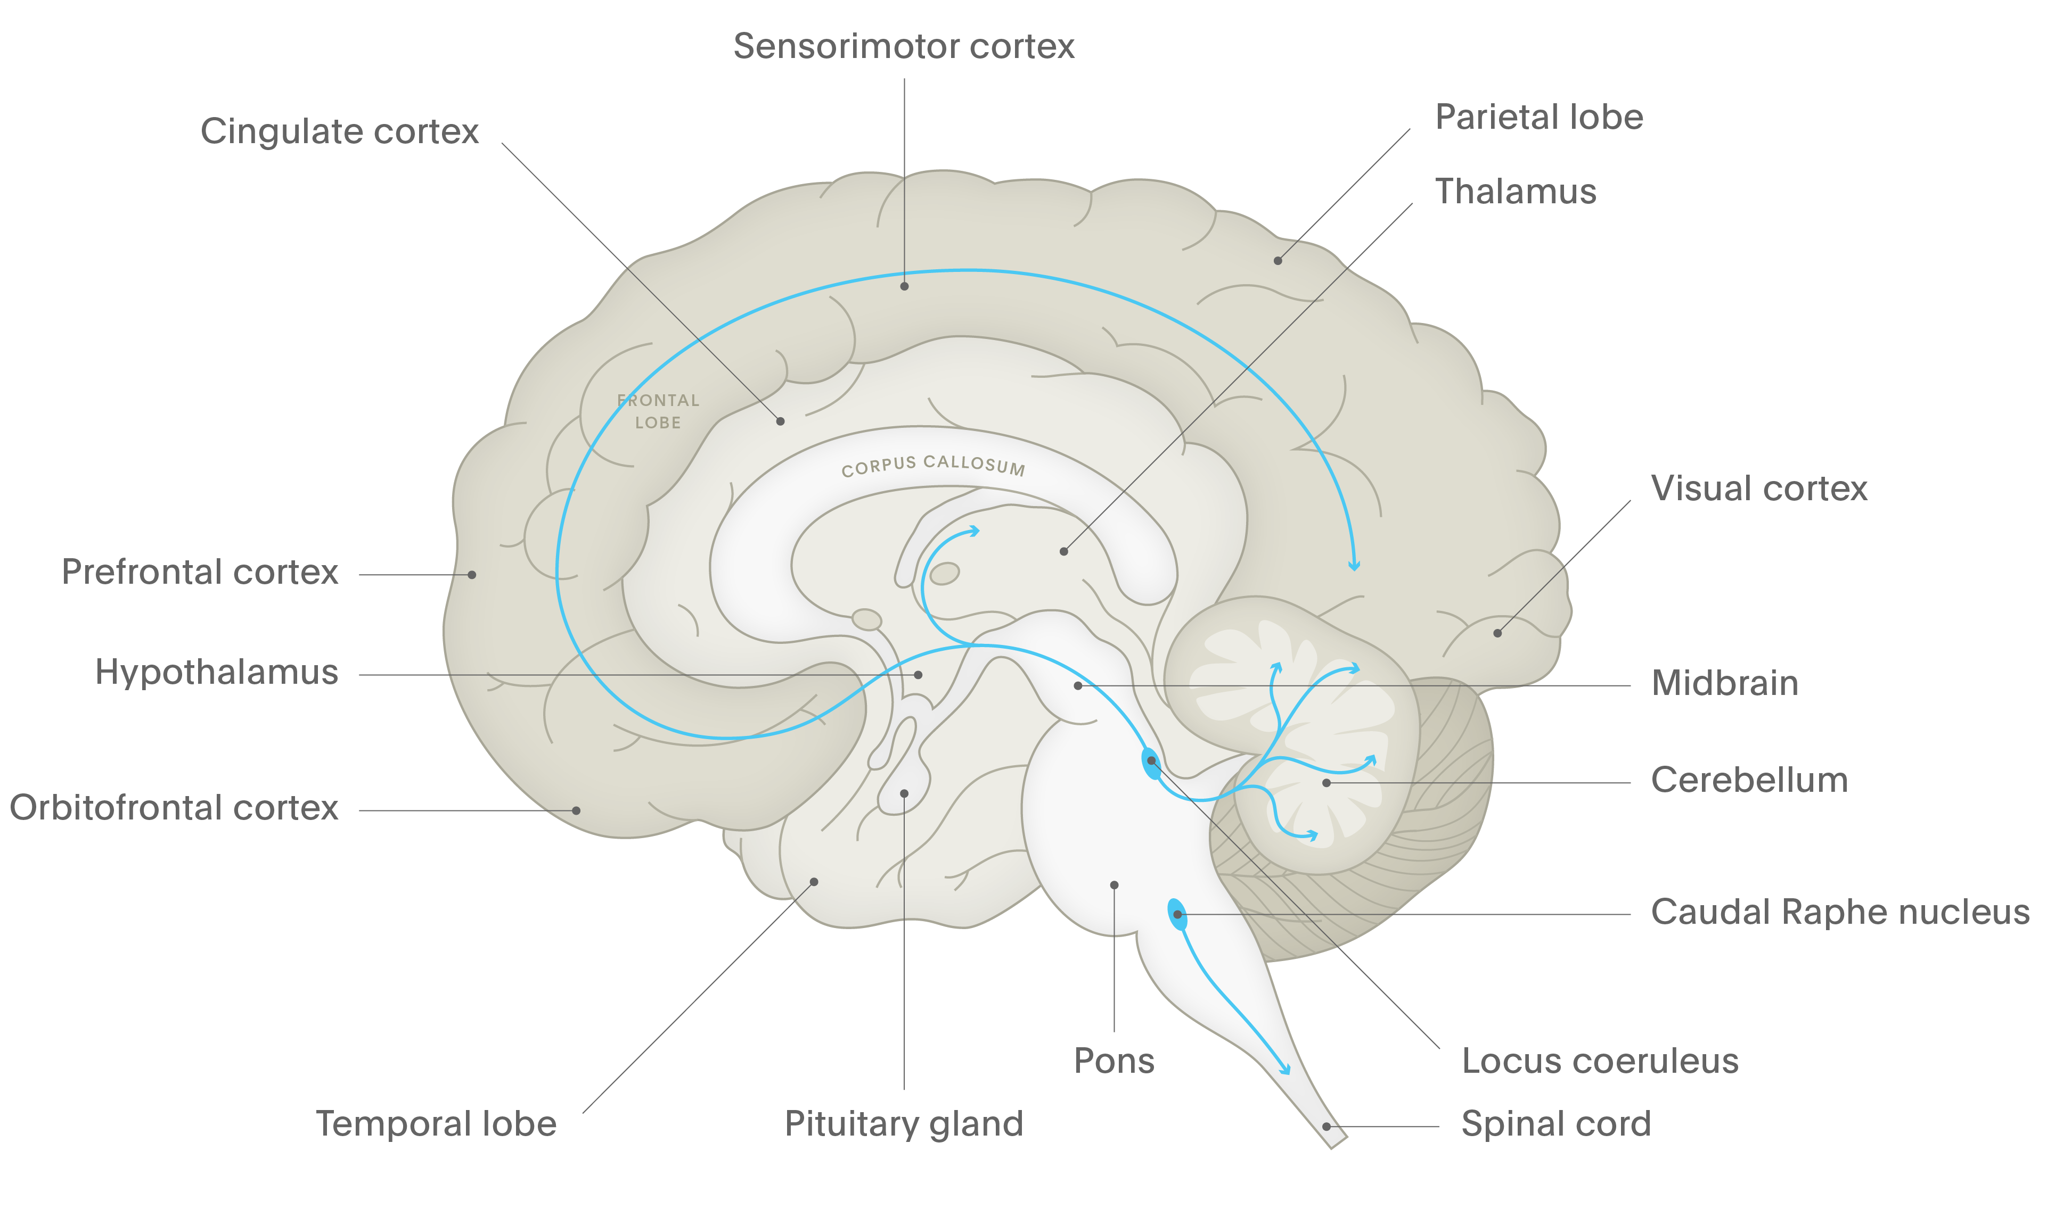
Noradrenaline
OH
HO
NH₂
Schizophrenia
Prefrontal cortex
Some noradrenergic projections to the frontal cortex are thought to help regulate mood; others are thought to mediate attention¹
The noradrenergic projection to the limbic cortex is thought to mediate emotions, energy, fatigue, and psychomotor agitation/retardation¹
HO
Noradrenaline (also called norepinephrine) is a neurotransmitter of neurones in the locus coeruleus^{1,2}
The principal function of the locus coeruleus is to prioritise competing incoming stimuli, whether external (e.g., a threat from the environment) or internal (e.g., pain), and to focus attention¹
Cerebellum
The noradrenergic projections to the cerebellum is thought to mediate motor movements, especially tremor¹
Locus coeruleus
Noradrenergic projections from the locus coeruleus project to the back of the brain, and are important in arousal and attention¹⁻³
Spinal cord
The noradrenergic projection to the brainstem controls blood pressure¹
1. Stahl. Stahl’s Essential Psychopharmacology. Neuroscientific Basis and Practical Applications. 2nd edition. 2000;
2. Purves et al. Neuroscience. 4th edition. 2008; 3. Dunn & Swiergiel. Eur J Pharmacol 2008;583:186–193
Notes:
Noradrenaline acts on two classes of adrenergic receptor, α and β.^{[Purves et al., 2008]} Noradrenergic neurones project widely throughout the brain, and there are many brain areas where serotonin, noradrenaline and dopamine projections overlap, allowing interactions.^{[Stahl, 2013]}
Noradrenaline and the locus coeruleus are thought to have important input into the control the CNS exerts over mood, cognition, stress, arousal, pain, and other functions.[Stahl, 2013; Dunn & Swiergiel, 2008] Malfunction of the locus coeruleus is thought to underlie disorders such as depression, anxiety, and disorders of attention and information processing.^{[Stahl, 2013]}
Low or abnormal noradrenaline activity is, theoretically, characterised by impaired attention; concentration, working memory and information processing difficulties; as well as psychomotor retardation, fatigue, and apathy.^{[Stahl, 2000]} In addition, abnormalities in the noradrenergic projection to the hypothalamus, which mediates stress response, are indicated in depressive and anxiety disorders.^{[Dunn & Swiergiel, 2008]}
References:
Dunn AJ, Swiergiel AH. The role of corticotropin-releasing factor and noradrenaline in stress-related responses, and the inter-relationships between the two systems. Eur J Pharmacol 2008; 583 (2–3): 186–193.
Purves D, Augustine GJ, Fitzpatrick D, et al. (eds). Neuroscience. 4th edition. Sinauer Associates, 2008.
Stahl SM. Stahl’s Essential Psychopharmacology. Neuroscientific Basis and Practical Applications. 2nd edition. © Cambridge University Press, 2000.
Stahl SM. Stahl’s Essential Psychopharmacology. Neuroscientific Basis and Practical Applications. 4th edition. © Cambridge University Press, 2013.

